Slide 1

Swan Valley Regional Secondary School
2026 - 2027 School Year

Slide 2


Agenda
General Information about SVRSS
Administration Personnel
Beliefs
Student Supports
Grade 9 Compulsory Courses
Grade 9 Elective Courses
SVRSS Overview
Bell Schedule
Semester System
Credit System
Fees
RTI/TAG
Communication Methods
Attendance expectations
Extra-curricular activities
Feel free to tour the school and speak with instructors

Slide 3
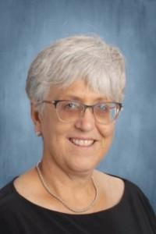
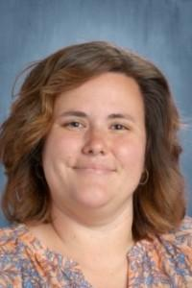
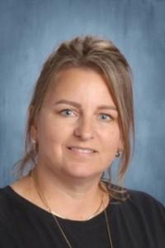
SVRSS Administration Team
Mrs. Jacquie Mydynski-Arp
Principal
Mrs. Kirsten Glen
Vice-Principal
Mrs. Jennifer Zamzow
Vice-Principal

Slide 4
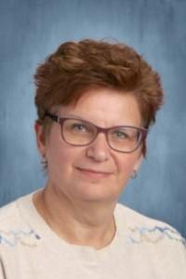
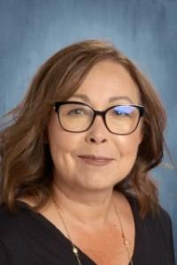
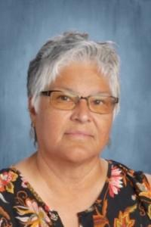
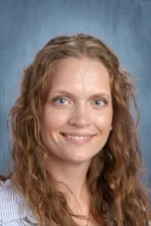
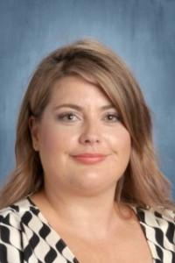
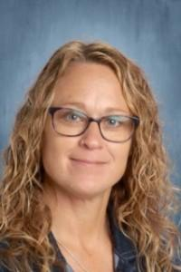
Learning Support Team at SVRSS
Tammy Badowski
Guidance Counsellor
Jennifer Barabash
Guidance Counsellor
Lorna Munro
Indigenous Academic Achievement Support Teacher
Katie Anderson
Resource Teacher
Jen Allan-Fuchs
Resource Teacher
Torey Werbicki
Home School Liaison

Slide 5

Other student supports….
Every Wednesday in the Learning Support Centre, we are fortunate to have our Teen Clinic who bring the services of 3 nurses.
Public Health Nurse
Mental Health Nurse
Nurse Practitioner – 2 times a month
HUB Youth Support – Weekly
You don’t need an appointment to access these services, just stop in on Wednesday morning.

Slide 6


Slide 7
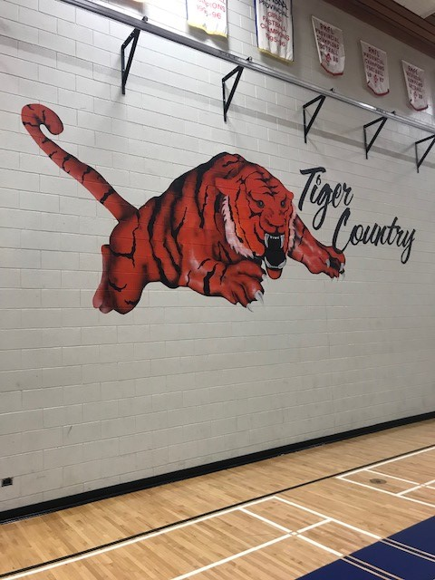

Slide 8
Grade 9 Compulsory Courses
All students take nine courses.
5 Compulsory Courses:
English Language Arts 10F (2 credits)
Math – Foundation 10F
110 hours of instruction (1 credit)
220 hours of instruction (2 credits)
Science 10F
Social Studies 10F
Physical Education 10F
Students may take up to 3 electives.

Slide 9
Grade 9 ELA
All Grade 9 students will take 2 ELA credits next year and receive up to two credits. They will be enrolled in an ELA class for the entire school year.
Students will continue to learn to understand, appreciate and use language in everyday life.
With the additional time in ELA, students will focus on skills needed with technology, AI, Digital literacy, Writing skills, non-fiction work and media literacy.
Students in French Immersion will take one ELA course and their Francais credit instead of the second ELA credit.

Slide 10
Grade 9 Math options
110 Hour Math = 1 credit
220 Hour Math = 2 credits
1 credit of math foundations
Meant for students who can work independently
Recommended for students who are usually able to easily complete assigned work within allotted class time.
If extra time at the end of course, enrichment preparation for Math: Introduction to Applied and Pre-Calculus Math
Possibility of 2 credits of math foundations
Twice the teacher contact time (70 minutes/day)
Ideal for students who need more support from their teacher to successfully complete assigned work
Opportunities for remediation as needed.

Slide 11
French Immersion Grade 9 Math Options
Students who are taking their French Immersion Diploma need to take at least 4 courses in French. One of their courses can be the French Immersion Math, however this course is a 1 credit option only.
Should FI diploma students choose to take their math in English, they have the option of doing either the 220-hour (2 credit) math or the 110-hour (1 credit) math and they will need to select another elective in French to make up the 4 Grade 9 French courses as required for the diploma program.

Slide 12
Frequently asked questions about math options….
Why wouldn’t all students take 220 hours of math?
Not all students need the double time and would benefit more from the quicker pace of the single credit.
I want to take math all year, do I have to take the 2 credits?
All Grade 9 students will take math all year regardless of program. Those taking it for 2 credits will take math for 70 minutes a day, those taking it for 1 credit will take math for 35 minutes a day or 70 minutes every second day.
I don’t want to miss the opportunity to take an extra elective.
Don’t worry, students get to choose a minimum of 2 electives in Grade 9 and all students get 4 electives in Grade 10. The Grade 9 cluster electives are designed to allow students the opportunity to sample a variety of different vocational areas.
What if I am still unsure about which math I should take?
We suggest you speak with your math teacher as he/she has the best understanding of your needs as a math student and can provide you with some guidance.

Slide 13
French Immersion Diploma Program
The French Immersion Diploma is available to all French Immersion students. Students enrolled in the French Immersion Diploma program will receive some courses with the Collabaunord Consortium; some of which will either be delivered in a classroom or through the video conference system. Students must earn at least 15 credits from courses taught in French to meet the requirements of the French Immersion Diploma.

Slide 14
Compulsory Grade 9 Courses for French Immersion Diploma
In Grade 9, French Immersion Diploma students need to take 4 FI credits. Here are their options:
1. Francais
2. Mathematiques
3. Sciences De La Nature 10F/20F
4. Le Canada Dans le Monde Contemporian 10F/Les enjeux geographiques du XXIe siècle 20F
*some students may choose to take an elective such as Vie – Travail Exploration as an additional FI credit or to replace Mathematiques.

Slide 15
French Immersion Certificate Program
The French Immersion Certificate Program is also an option for French Immersion students. Students who choose the French Immersion Certificate program must successfully complete between 7 and 14 credits in French.
Most students who choose this option will select 2 French Immersion courses per year, usually in Grade 9 it is Francais and 1 other.

Slide 16
Electives…

Slide 17
What are electives?
Electives are the interest-based courses that you get to pick based on your interests.
Some of our electives are full credit while others are cluster credits. They will start at the beginning of the semester and end when the semester ends.
The cluster courses are made up of courses from 4 different areas .
Some of our elective areas can lead to apprenticeship accreditation, if you find an area you enjoy and would like more information contact one of our Guidance Counsellors.

Slide 18
Cluster A: Creative Arts
This course will focus students on a variety of fine arts that will allow an exploration of ways to express and engage in the arts.
Students will spend approximately 5 weeks in each area.
Areas of focus: Drama, Motion Picture Arts, Performing Arts and Visual Arts

Slide 19
Cluster B: Heavy Industrial
This course will focus students on a variety of heavy industrial shop skills as well as linking these vocational areas to finances and business.
Students will spend approximately 5 weeks in each area.
Areas of focus: Automotive, Business, Heavy Duty and Welding

Slide 20
Cluster C: Light Industrial
This course will focus students on personal wellness, through exploration of communication methods, our environment, nutrition and other personal skills.
Students will spend approximately 5 weeks in each area.
Areas of focus: Culinary Arts, Environmental Management, Graphic Communication and Human Ecology

Slide 21
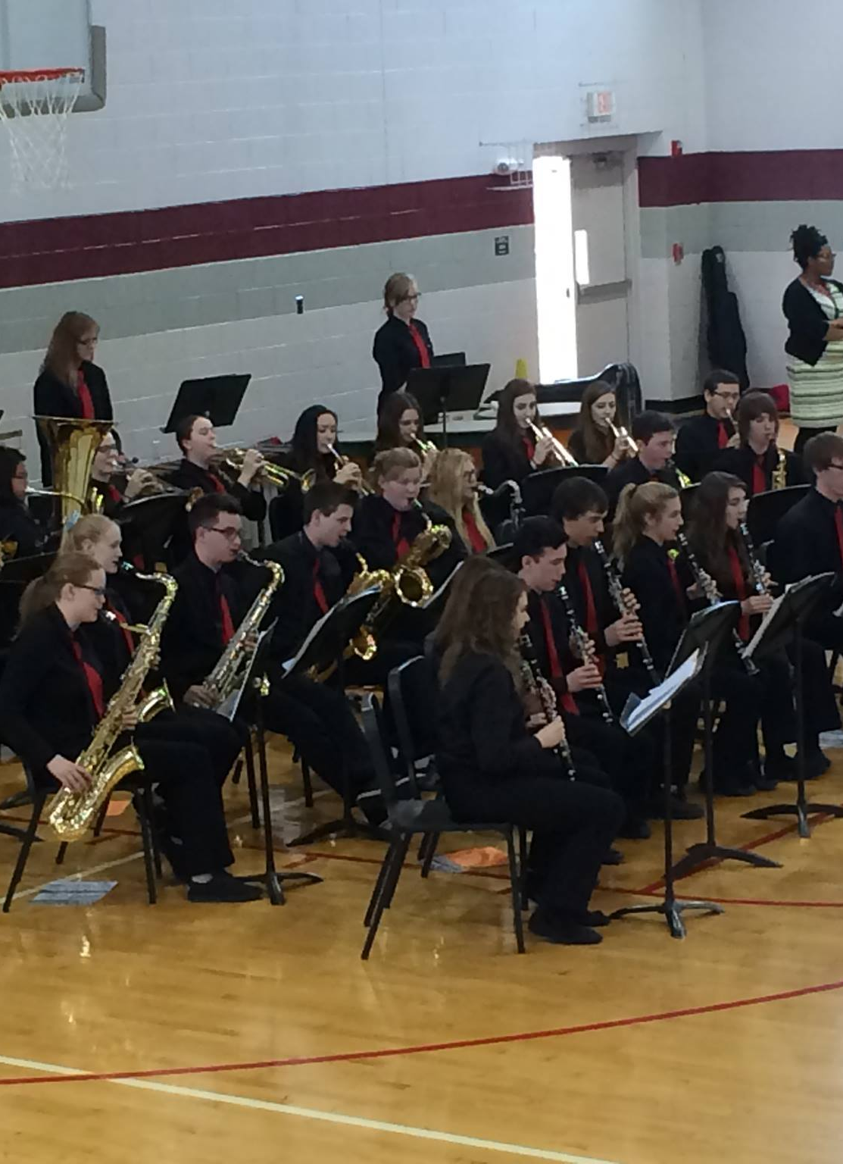
Fine Arts: Concert Band
This emphasis of this course is the performance of various musical styles and forms in a large ensemble setting. Members of the band program continue to develop their instrumental musicianship through the repertoire studied in class as well as opportunities to reflect and connect music to various times, places, and groups. Workshops, concerts, tours, and festivals are an intrinsic part of the band program.

Slide 22





Fine Arts: Jazz Band
Students learn to perform various styles of jazz music such as blues, swing, Latin and rock through rehearsal, listening and jazz history.
This class is performance focused, and all members are required to participate in a variety workshops, concerts, tours and festivals.
This Photo by Unknown author is licensed under CC BY-SA-NC.

Slide 23




Fine Arts: Strings
This is an introduction course to a stringed instrument. Students do not need to have any experience in playing, nor reading music. The learner will develop skills to produce music on their selected stringed instrument such as guitar, violin/fiddle and so on.

Slide 24
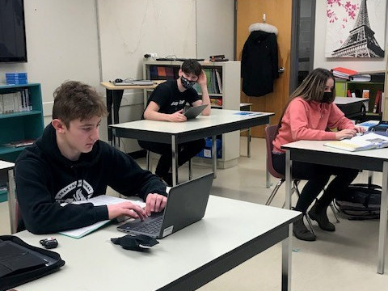
Languages French: Communication and Culture
The goal of this course is to give students the opportunity to acquire the necessary language skills to communicate in French.
Students will learn to express themselves orally and engage in conversation in a variety of situations.
The majority of the semester is spent reviewing and mastering basic skills, through oral communication, reading and writing, and discovering aspects of francophone cultures.
Course instruction provided in English, building French Language Skills.

Slide 25

Languages: Cree
This introductory course focuses on the basics of the Cree language. With five distinct dialects throughout Canada, this course will introduce students to the Plains Cree, 'n' dialect. Participation with in-class and off-site language and cultural activities is encouraged for students to learn, practice, and display their oral skill development. Along with the implementation of traditional teachings, students learn to read, write, and speak at the basic level of proficiency in the Swampy Cree language.

Slide 26
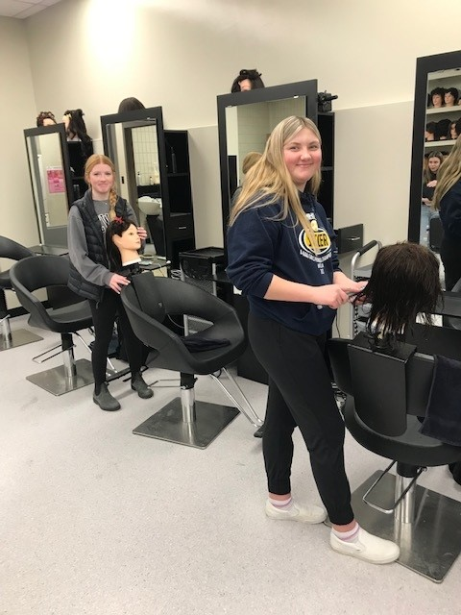
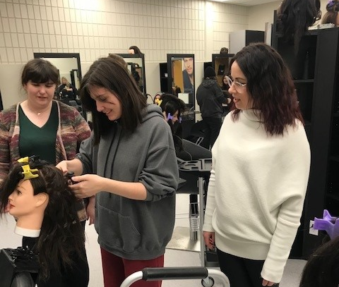
Introduction to Hairstyling
This is a full credit course that introduces students to hairstyling, with a focus on safety and sanitation, basic tools and equipment, the operation of a hairstyling salon, the workings of the industry and intro skills such as braiding, thermal styling and roller setting.

Slide 27
Grade 10 Electives
There are 2 elective areas that are not available to students when they are in Grade 9;
Carpentry
Electrical
If students wish to take courses in either of these vocational areas they will be able to request it when they do their course selection for Grade 10.
Also, if students are only interested in one course from a cluster but do not wish to take the whole cluster they will need to wait until Grade 10.

Slide 28
So how many electives will my child take next year?
Depending on which math you choose (110 hour or 220 hour) you will either get 2 or 3 electives.
Students who choose to take the “double” math (70 minutes/day) will get 2 electives.
Students who choose to take the 110 hour math (35 minutes/day or 70 minutes every second day) will get 3 electives.
Remember, all students in Grade 10 will get to take 4 electives so anything you don’t take in Grade 9 you can take in Grade 10

Slide 29
Bell Schedule
Bell Schedule | Semester 1 | Semester 2
8:55 AM | Warning Bell
9:00 AM – 10:10 AM | Block 1 | Block 1
10:10 AM – 11:20 AM | Block 2 | Block 2
11:20 AM – 11:55 PM | Block 3
11:55 PM – 12:55 PM | Lunch
12:45 PM | Warning Bell
12:55 PM – 2:05 PM | Block 4 | Block 4
2:05 PM – 2:30 PM | TAG/RTI
2:30 PM – 3:40 PM | Block 5 | Block 5

Slide 30
General Information
Semester System: The school operates on a semester system as follows;
Semester 1 – September to January
Semester 2 – February to June
Credit System: Credits are awarded for successful completion of courses
Graduation: The minimum requirement for graduation – 30 credits. Students must also have all the compulsory courses as per the High School Program Model.

Slide 31
General Information
Student Activity Fee: $60.00, non-refundable fee, used to pay for the cost of student activities and a yearbook.
Locker: All students Grade 9 – 11 are assigned their own locker.
Textbooks: Provided at no cost, however if a book is lost, student will be charged replacement cost of the text.
Drop-off and pick-up: Please use the lane at the north end of the school. We ask that vehicles move ahead and do not stop at the north entrance. This is a one-way road with 2 lanes.

Slide 32
What is RTI?
Response to Intervention
To address student learning, mental wellness and to build connections, the SVRSS has implemented a Response to Intervention or RTI.
Students are assigned to 1 teacher for the entire year. Attendance is mandatory.
This is in response to student data which identified the need for time in the student’s day with their teachers.
Students can use this 25 - minute block of time to review concepts, complete homework, prepare for assessments and complete missing assessments.

Slide 33
Student Achievement Reporting
Semester 1
Report cards and Parent-Teacher Interviews – mid November
Final grades at the end of January
Semester 2
Report cards and Parent-Teacher Interviews – April
Final grades at the end of June
Report cards are emailed home to families at both the mid point in the semester and also at the end of the semester.

Slide 34

PowerSchool Portal
All parents are encouraged to stop in at the high school to set up their PowerSchool portal.
From the app, parents can see their students’ marks and attendance in real time as well as being able to see any missing assignments or upcoming assignments.
Most students and parents find this to be a very powerful and helpful tool
Please see Mrs. Cathy Petelski in the Resource Centre to activate your account.

Slide 35
Other methods of communication
SVRSS frequently uses a messaging system that allows us to send voice messages and emails to families. If your son or daughter is marked “late” or “truant”, you should receive a message from our system.
We also have a Swan Valley School Division website that we encourage all parents to check regularly.
The Swan Valley School Division and SVRSS have a Facebook page to help keep our families informed, please take a minute to like our page if you are on Facebook.

Slide 36
SVRSS Attendance
At SVRSS we believe that good attendance is directly related to success.
If your son/daughter must miss a day of school, please contact the office to inform them of the absenteeism. svrssabsence @svsd.ca
If you are taking your child out of school part way through the day or bringing them back to school, we ask that you email or phone the office staff and they will adjust the attendance.
Students who frequently miss class can expect interventions such as; phone calls from your teacher, RTI focused support to assist students to get back on track

Slide 37
Digital Citizenship
Cell phone usage at SVRSS

Slide 38

Opportunities to enrich your high school experience
School Sports Teams
volleyball
soccer
golf
football
basketball
cross-country running
badminton
curling
track and field
rugby
hockey
fastball
baseball

Slide 39

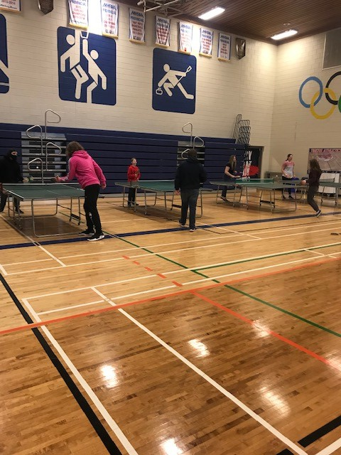
Intramurals

Slide 40

There are many ways to get involved in your school.
Additional Extra-Curricular Activities:
Yearbook
Student Council
Social Justice/Youth in Philanthropy
T.A.D.D. Teens Against Dangerous Decisions
Envirothon
Skills Canada
G. S. A. club
Art Club
Intramurals
Chess Club
Gaming Club
E-sports Team
Multicultural Group
Drama productions
*Travel opportunities

Slide 41
Thank-you for attending
The powerpoint slideshow from tonight is available on our website as well as the Grade 9 Registration Information and the Grade 9 Course Selection sheet.
https://www.svsd.ca/svrss/grade-8-school-tours-open-house.4077
We look forward to working with you and your children next fall!

