Slide 1

Swan Valley Regional Secondary School
Grade 12 Course Registration

Slide 2
Course Selection
Today we will review your course options and discuss decisions that need to be made.
You will also be given your course registration sheets.
Once we return from spring break, you will be called down to enter your course requests into your “My Blueprint” account.
If you have any questions, please book an appointment with one of the guidance counselors before entering your course selections.

Slide 3

Grade 12 Compulsory Courses
English Language Arts
Comprehensive Focus
Literary Focus
Mathematics
Applied
Essentials
Pre-Calculus
Physical Education
25% in class 75% out of class
Lifeguard Course – 100% in class
100% in class
Education Physique 40F

Slide 4
What is the difference between Comprehensive and Literary Focus?
Comprehensive Focus
This course balances practical and literary purposes and uses of language.
Students explore and use language for practical purposes such as to inform, direct, persuade, plan, analyze, and explain.
During the course, students communicate orally, in writing and visually.
This course is similar in layout to the Grade 10 foundations course
Literary Focus
This is a course for students who wish to focus on creative and literary forms of language.
Students study and produce a variety of spoken, written and visual texts that promote understanding and empathy, reflect culture, express feelings and experiences, and bring enjoyment.
Students may also study and produce reviews, discussions or interpretations of various texts.

Slide 5
What is the difference between Comprehensive, Literary and Transactional Focus?
Comprehensive
Literary
Transactional
This course balances practical and literary purposes and uses of language.
Students explore and use language for practical purposes such as to inform, direct, persuade, plan, analyze, and explain.
During the course, students communicate orally, in writing and visually.
This course is similar in layout to the Grade 10 foundations course.
This is a course for students who wish to focus on creative and literary forms of language.
Students study and produce a variety of spoken, written and visual texts that promote understanding and empathy, reflect culture, express feelings and experiences, and bring enjoyment.
Students may also study and produce reviews, discussions or interpretations of various texts.
This course focuses on the day-to-day use of language for a variety of practical purposes.
Students read, watch, listen and respond to various forms of communication. They speak, write and communicate visually for different purposes including informing, persuading, analyzing and explaining.
Students may, for example, critically examine television commercials and news broadcasts, write articles and editorials, or listen to radio broadcasts and speeches to gather information and ideas.

Slide 6
Supplementary English course at the grade 12 level
English Language Arts: Language and Literacy Forms
This course will explore a variety of literary genres familiarizing students with many approaches used in college and/or university studies.
Students will develop critical thinking skills and fundamentals in academic research and writing with a focus on specific styles such as MLA, APA, Chicago, etc.
Evaluation of this course will be in the form of a final paper/essay.

Slide 7
Social Studies
There are no compulsory Grade 12 Social Studies courses, but it is highly recommended that students planning for post-secondary studies take at least 1 Grade 12 Social Studies elective.
Social Studies courses that are available to our Grade 12 students are:
Global Issues: Citizenship & Sustainability 40S
Current Topics in First Nations, Metis and Inuit Studies 40S
Land and Treaties: Relationships & Responsibilities 40S New
Psychology/Canadian Law 40S

Slide 8
The next decision…..
Which math should you take?
Which math did you take in Grade 11?
You can continue with the same math or switch to a different math.
Applied Math
Essential Math
Pre-Calculus Math

Slide 9
Applied Math
This is a course for students interested in post-secondary programs that do not require a study of theoretical mathematics such as Calculus or Linear Algebra,but may involve further study in applied mathematics courses such as Statistics. Students learn to use mathematics to solve problems related to real life situations, often using technology such as graphing calculators. It is recommended that students earn a credit in this course or in Grade 11 Pre-Calculus Mathematics to continue in Grade 12 Applied Mathematics
The topics studied in Grade 11 Applied Mathematics are: Analyzing Puzzles and Games, Quadratic Functions, Scale, Trigonometry, Inductive and Deductive Reasoning, Statistics and Mathematics Research Project.

Slide 10
Essential Math
The Essential Mathematics course is for students who are interested in post-secondary studies that do not require advanced mathematics (areas such as fine arts, geography, nursing, social work and others)
It is also for students wanting to learn mathematics for their personal and work-related use after high school, and for some of the trade apprenticeship programs.
The topics studied in this course are: Analysis of Games and Numbers, Interest and Credit, 3-D Geometry, Statistics, Managing Money, Relations and Patterns, Trigonometry and Design Modeling.

Slide 11
Pre-Calculus Math
This course is for students who are interested in post-secondary programs that may require further study in theoretical mathematics such as Calculus or Linear Algebra. Students learn to use algebra to solve problems that may or may not be related to real life situations.
The topics studied in this course are: Trigonometry and the Unit Circle, Trigonometric Equations and Identities, Function Transformations, Operations, Compositions, and Inverses, Exponential and Logarithmic Functions, Polynomial Functions, Radical Functions, Rational Functions, Permutations, Combinations and the Binomial Theorem

Slide 12
Additional Math Courses for grade 12 students
Intro. to Calculus
Calculus 45S is offered as an optional 1/2 credit course to motivated students who wish to have an introduction to areas of mathematics which will be studied in depth in post-secondary programs. The calculus program is divided into 4 units: limits, derivatives of functions, applications of derivatives, and integration
Advanced Mathematics
This course is also offered as an optional ½ credit course, it introduces topics which will appear in a wide range of mathematical fields. Topics will include Matrices, Polar Coordinates, Complex Numbers, Statistics and limits as well as calculus topics of differentiation and integration. The purpose of this course is to assist those students who will be required to take Statistics at the university level.

Slide 13
Continuous math throughout high school
It is possible that a students may take their Grade 11 math in the first semester and not take their Grade 12 math until the following year second semester, this puts a student at a disadvantage – a full year with no math instruction.
We would like to recommend that students consider taking a second math course as an elective to round out their math instruction. For example;

Slide 14
Grade 11 |  | Grade 12
Semester 1 | Semester 2 | Semester 1 | Semester 2
Grade 11 Pre-Calc | Grade 12 Applied | Grade 12 Pre-Calculus or Applied | Intro. To Calculus
Grade 12 Applied | Grade 11 Pre-Calc |  | Advanced Math
 | Grade 12 Essentials

Slide 15
Physical Education
Physical Education 40F is a compulsory course for all students graduating in Manitoba.
There are 3 options for students to complete these credits.
PED40F1 25% in class and 75% out of class
PED40F2 100% in class
PED40F3 100% in class – lifeguarding course
PEDF40F 25/75% - Education Physique

Slide 16
Science options….
Science is not a required course at the Grade 12 level, however we strongly recommend that all Grade 12 students continue with at least 1 of the advanced science courses through to graduation.
The three science courses are:

Slide 17
Biology | 30S | This course is an overview of the systems that constitute the human body as well as the processes that regulate it.
 | 40S | This course looks at how the cells nuclei direct protein synthesis. It also includes genetics, heredity and the biochemical processes. * Students do not need to take BIO30S before taking BIO40S
Chemistry | 30S | The goal is to understand how basic chemistry relates to technology and society in everyday life.
 | 40S | The course expands on the topics previously covered with emphasis on electron structure, chemical equilibrium, and rates of reaction, acid bases, solubility, oxidation-reduction, and electrochemistry
Physics | 30S | This course is an introduction to physics that includes measurement, graphical analysis, and vectors.
 | 40S | As in Physics 30S, mathematical relationships and problem solving are emphasized.

Slide 18
Other elective options to consider…..
SVRSS students are very fortunate to have many different elective options available to them, in addition to all the academic course options.
New options for Grade 12 students are;
Land and Treaties: Relationships & Responsibilities 40S
Exercise Science 40S
Textile Art & Design 40S

Slide 19

Elective areas
Applied Commerce
Automotive Technology*
Carpentry*
Culinary Arts*
Electrical Trades Technology*
Fine Arts (Band. Strings, Choral, Jazz, Performing Arts, Drama, Visual Arts)
Graphic Communication
Hairstyling*
Health Care Aide (Semester 2 only)
Heavy Duty Equipment Technician*
Human Ecology (previously Family Studies)
Languages: Cree and French
Motion Picture Arts
Resources and Environmental Management
Welding Technology*

Slide 20

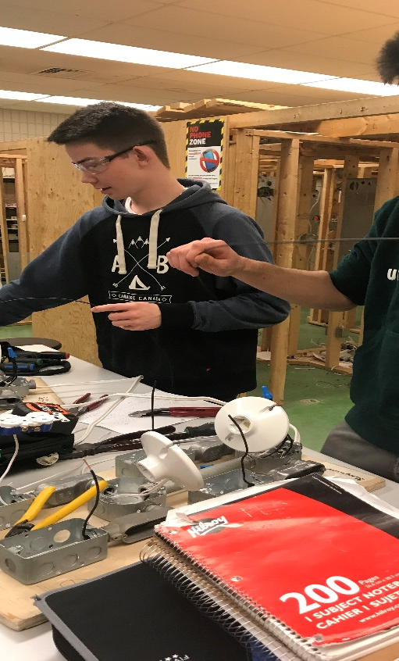
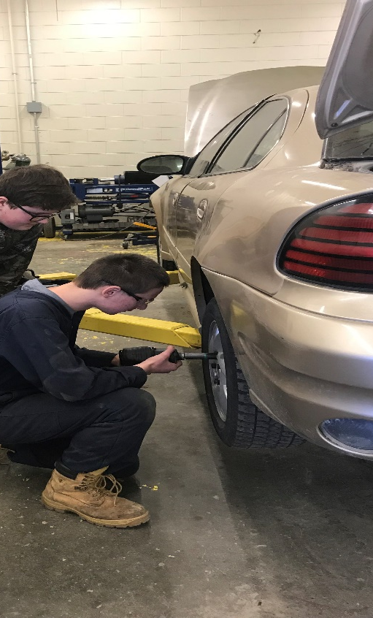



Earn while you Learn
Apprenticeship Accredited programs at SVRSS provide a wonderful opportunity for our students to get a head start on their post-secondary apprenticeships.
Students who complete all courses within 1 of the accredited programs with all marks at 70% or better, will receive the accreditation number on their transcript which will give them credit for Level 1 Technical Training should they choose to pursue further training in apprenticeship.

Slide 21

Apprenticeship Accredited Programs
Automotive Technology
Carpentry
Culinary Arts
Electrical
Hairstyling
Heavy Duty
Welding Technology

Slide 22
Apprenticeship Accredited Programs
If you plan to complete one of the 7 accredited programs, you need to meet with a counselor to make sure you have taken all the courses in your program.
You will also need to check on the marks you have received ensuring that they meet the 70% minimum.

Slide 23

Health Care Aide program – dual credit
The Health Care Aide program is available to Grade 12 students. It is designed to provide students with on-the-job training.
This is a demanding set of 5 courses. Students who wish to pursue this option at the Grade 12 level need to start planning early as they will need to complete all compulsory courses in their Grade 11 year and the 1st semester of Grade 12.
This program allows students the benefit of completing their high school graduation and the UCN Health Care Aide Certificate at the same time.
*Students who wish to follow this path are encouraged to meet with a counselor to plan their courses.

Slide 24
How many courses do I need to pick?
All students will need to select their compulsory courses:
ELA: Comprehensive or Literary Focus
Math: Applied, Essential or Pre-Calculus
Phys. Ed: 25%-75%/lifeguarding course/100%
Grade 12 students need to select the electives they need. For some that will be academic electives i.e. Physics 40S, for others it will be your remaining courses for accreditation.
The number of courses you take in Grade 12 is based on what you need.

Slide 25
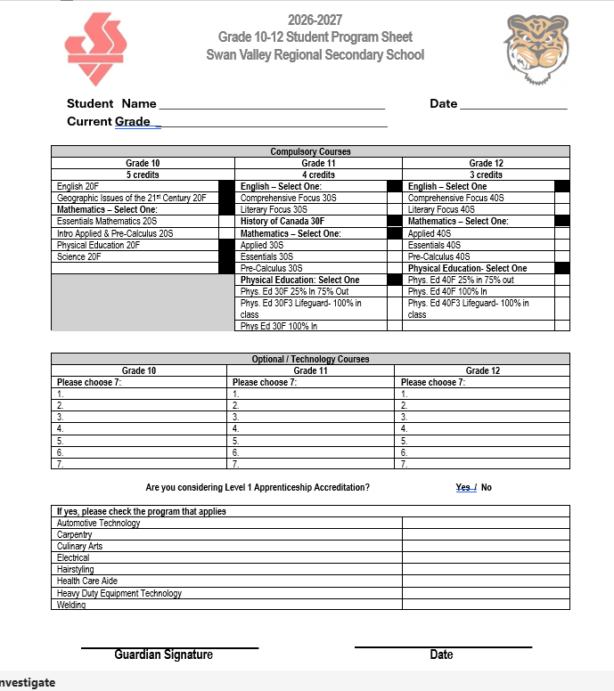
Here is what your course selection form will look like.
Grade 12 students need to fill in the column on the right.

Slide 26
Now what?
Take your form home and discuss everything with your parents/guardians.
Bring your signed course registration form back by April 7
We will be meeting in the Resource Centre, you will be called down.
Bring your registration sheet signed by your parents!!!
Make sure you know your username and your password for MyBluePrint, if you don’t remember what it is please go into MyBluePrint and reset your password.

Slide 27

That’s it for now!
Please see a counselor if you have any questions about your course selection.

