Slide 1

Swan Valley Regional Secondary School
Grade 11 Course Registration

Slide 2
Course Selection
Today we will review your course options and discuss decisions that need to be made.
You will also be given your course registration sheets.
Next week you will be called down to enter your course requests into your “My Blueprint” account.
If you have any questions, please book an appointment with one of the guidance counselors before entering your course selections.

Slide 3

Grade 11 Compulsory Courses…
English Language Arts
Comprehensive Focus
Literary Focus
History of Canada
Mathematics
Applied
Essentials
Pre-Calculus
Physical Education
25% in class 75% out of class
Lifeguard Course – 100% in class
100% in class
  Education Physique 30F

Slide 4
What is the difference between Comprehensive and Literary Focus?
Comprehensive
Literary
Transactional
This course balances practical and literary purposes and uses of language.
Students explore and use language for practical purposes such as to inform, direct, persuade, plan, analyze, and explain.
During the course, students communicate orally, in writing and visually.
This course is similar in layout to the Grade 10 foundations course.
This is a course for students who wish to focus on creative and literary forms of language.
Students study and produce a variety of spoken, written and visual texts that promote understanding and empathy, reflect culture, express feelings and experiences, and bring enjoyment.
Students may also study and produce reviews, discussions or interpretations of various texts.
This course focuses on the day-to-day use of language for a variety of practical purposes.
Students read,watch, listen and respond to various forms of communication. They speak, write and communicate visually for different purposes including informing, persuading, analyzing and explaining.
Students may, for example, critically examine television commercials and news broadcasts, write articles and editorials, or listen to radio broadcasts and speeches to gather information and ideas.

Slide 5
What is the difference between Comprehensive and Literary Focus?
Comprehensive Focus
This course balances practical and literary purposes and uses of language.
Students explore and use language for practical purposes such as to inform, direct, persuade, plan, analyze, and explain.
During the course, students communicate orally, in writing and visually.
This course is similar in layout to the Grade 10 foundations course
Literary Focus
This is a course for students who wish to focus on creative and literary forms of language.
Students study and produce a variety of spoken, written and visual texts that promote understanding and empathy, reflect culture, express feelings and experiences, and bring enjoyment.
Students may also study and produce reviews, discussions or interpretations of various texts.

Slide 6

Social Studies
The compulsory course for all students at the Grade 11 level is Canadian History/Histoire du Canada it is a requirement for all students graduating with their Manitoba Diploma.
Elective Social Studies courses are:
Agriculture 30S
Additional Social Studies courses that are available to our Grade 11 and 12 students are:
Global Issues: Citizenship & Sustainability 40S
Land & Treaties: Relationships & Responsibilities 40S (new this year)
Current Topics in First Nations, Metis and Inuit Studies 40S
Canadian Law 40S (offered in 2026-2027)
Psychology 40S(offered in the 2025-26 school year)

Slide 7
The next decision…..
Which math should you take?
What does your math teacher recommend?
Which math did you take in Grade 10?
Applied Math
Essential Math
Pre-Calculus Math

Slide 8
Applied Math
This is a course for students interested in post-secondary programs that do not require a study of theoretical mathematics such as Calculus or Linear Algebra, but may involve further study in applied mathematics courses such as Statistics. Students learn to use mathematics to solve problems related to real life situations, often using technology such as graphing calculators. It is recommended that students earn a credit in this course or in Grade 11 Pre-Calculus Mathematics to continue in Grade 12 Applied Mathematics
The topics studied in Grade 11 Applied Mathematics are: Analyzing Puzzles and Games, Quadratic Functions, Scale, Trigonometry, Inductive and Deductive Reasoning, Statistics and Mathematics Research Project.

Slide 9
Essential Math
The Essential Mathematics course is for students who are interested in post-secondary studies that do not require advanced mathematics (areas such as fine arts, geography, social work and others)
It is also for students wanting to learn mathematics for their personal and work-related use after high school, and for some of the trade apprenticeship programs.
The topics studied in this course are: Analysis of Games and Numbers, Interest and Credit, 3-D Geometry, Statistics, Managing Money, Relations and Patterns, Trigonometry and Design Modeling.

Slide 10
Pre-Calculus Math
This course is for students who are interested in post-secondary programs that may require further study in theoretical mathematics such as Calculus or Linear Algebra. Students learn to use algebra to solve problems that may or may not be related to real life situations.
The topics studied in this course are: Trigonometry and the Unit Circle, Trigonometric Equations and Identities, Function Transformations, Operations, Compositions, and Inverses, Exponential and Logarithmic Functions, Polynomial Functions, Radical Functions, Rational Functions, Permutations, Combinations and the Binomial Theorem

Slide 11
Traditional Mathematics Pathways
Grade 10 Grade 11 Grade 12
Essentials 20 Essentials 30 Essentials 40
Applied 30 Applied 40
Intro. Applied and Pre-Calc
Pre-Calc 30 Pre-Calc 40
* Students completing their Pre-Calc 40 are also able to take their Introduction to Calculus to help smooth the transition to University Calculus or Advanced Mathematics which helps those students who will transition to Statistics at the post-secondary level.

Slide 12
Continuous math throughout high school
You have the option to continue with this pathway or make a change to one math course in Grade 11 and 12.
Did you take continuous math in Grade 10?

Slide 13
Grade 11 |  | Grade 12
Semester 1 | Semester 2 | Semester 1 | Semester 2
Grade 11 Pre-Calc | Grade 12 Applied | Grade 12 Pre-Calculus or Applied | Intro. To Calculus

Slide 14
Physical Education
Physical Education 30F and 40F is a compulsory course for all students graduating in Manitoba.
There are 3 options for students to complete these credits.
PED30F1 25% in class and 75% out of class
PED30F3 100% in class – lifeguarding course
PEDF30F 25/75% - Education Physique
PED30F2 100% in the gym

Slide 15
Science options….
Science is not a required course at the Grade 11 and 12 level, however we strongly recommend that all Grade 11 and 12 students continue with at least 1 of the advanced science courses through to graduation.
The three science courses are:

Slide 16
Biology | 30S | This course is an overview of the systems that constitute the human body as well as the processes that regulate it.
 | 40S | This course looks at how the cells nuclei direct protein synthesis. It also includes genetics, heredity and the biochemical processes. * Students do not need to take BIO30S before taking BIO40S
Chemistry | 30S | The goal is to understand how basic chemistry relates to technology and society in everyday life.
 | 40S | The course expands on the topics previously covered with emphasis on electron structure, chemical equilibrium, and rates of reaction, acid bases, solubility, oxidation-reduction, and electrochemistry
Physics | 30S | This course is an introduction to physics that includes measurement, graphical analysis, and vectors.
 | 40S | As in Physics 30S, mathematical relationships and problem solving are emphasized.

Slide 17
Other elective options to consider…..
SVRSS students are very fortunate to have many different elective options available to them, in addition to all the academic course options.
A new option for Grade 11 students next year is Textile Art & Design.

Slide 18

Elective areas
Applied Commerce
Automotive Technology*
Carpentry*
Culinary Arts*
Electrical Trades Technology*
Fine Arts (Band. Strings, Choral, Jazz, Performing Arts, Drama, Visual Arts)
Graphic Communication
Hairstyling*
Health Care Aide (Grade 12 only, but start planning in Grade 11)
Heavy Duty Equipment Technician*
Human Ecology (previously Family Studies)
Languages: Cree and French
Motion Picture Arts
Resources and Environmental Management
Welding Technology*

Slide 19
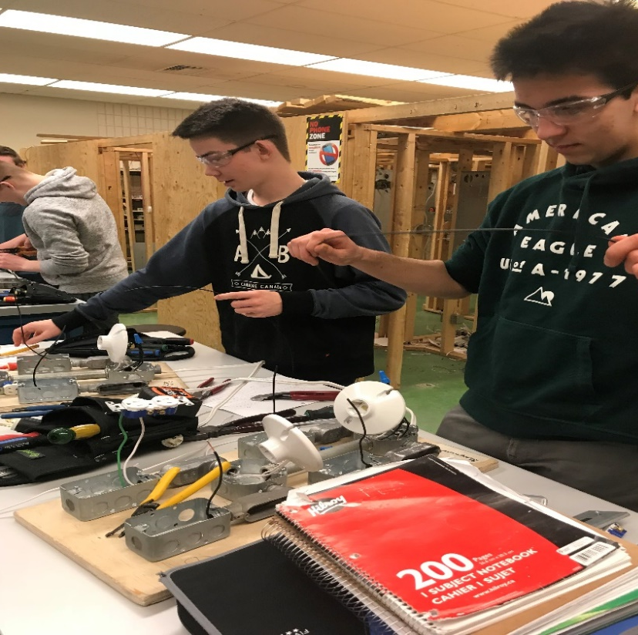

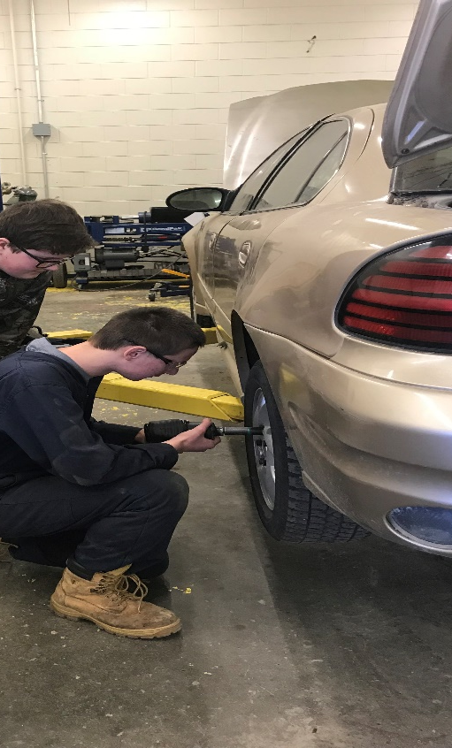



Earn while you Learn
Apprenticeship Accredited programs at SVRSS provide a wonderful opportunity for our students to get a head start on their post-secondary apprenticeships.
Students who complete all courses within 1 of the accredited programs with all marks at 70% or better, will receive the accreditation number on their transcript which will give them credit for Level 1 Technical Training should they choose to pursue further training in apprenticeship.

Slide 20

Apprenticeship Accredited Programs
Automotive Technology
Carpentry
Culinary Arts
Electrical
Hairstyling
Heavy Duty
Welding Technology

Slide 21
Health Care Aide program – dual credit
The Health Care Aide program is available to Grade 12 students. It is designed to provide students with on-the-job training.
This is a demanding set of 5 courses. Students who wish to pursue this option at the Grade 12 level need to start planning early as they will need to complete all compulsory courses in their Grade 11 year and the 1st semester of Grade 12.
This program allows students the benefit of completing their high school graduation and the UCN Health Care Aide Certificate at the same time.
*Students who wish to follow this path are encouraged to meet with a counselor to plan their courses.

Slide 22

Things to think about for next year...
Are you hoping to complete an Apprenticeship Accreditation program? If so, start planning for that now.
If you are considering the Health Care Aide dual credit program in Grade 12, start planning ahead now.
Are you thinking about going out of province for your post-secondary? If so, maybe consider taking a Grade 12 Social Science in Grade 11 (Global Issues, FNMI, Canadian Law )

Slide 23
How many courses do I need to pick?
All students will need to select their compulsory courses:
  ELA: Comprehensive or Literary Focus
  Math: Applied, Essential or Pre-Calculus
  Phys. Ed: 25%-75%/lifeguarding course/100% in class
All Grade 11 students will need to select Canadian History
All students will need to select 7 electives, number them in order from your first choice (#1) to your 7th choice (#7) on your sheet.
  Consider these choices very carefully!!!

Slide 24
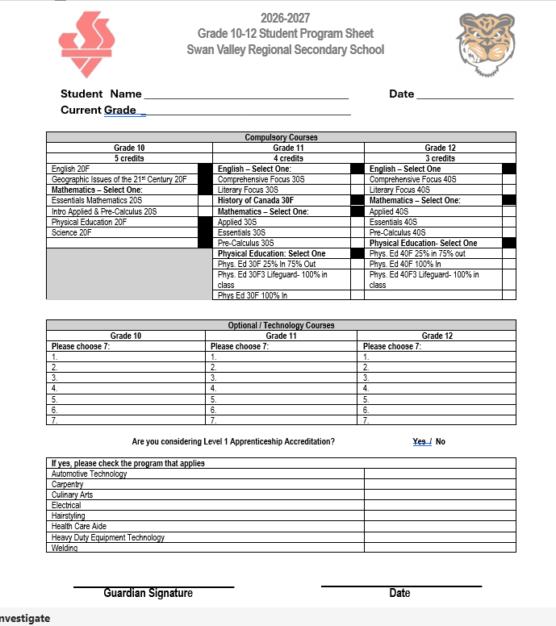
Here is what your course selection form will look like.

Slide 25
Now what?
Take your form home and discuss everything with your parents/guardians.
Bring your signed course registration form back Tuesday, April 7.
The week after spring break we will be meeting in the Resource Centre to enter your choices.
Bring your registration sheet signed by your parents!!!
Make sure you know your username and your password for MyBluePrint, if you don’t remember what it is please go into MyBluePrint and reset your password.

Slide 26

That’s it for now!
Please see a counselor if you have any questions about your course selection.

