Slide 1

Swan Valley Regional Secondary School
Grade 10 Course Registration

Slide 2
Course Selection
Today we will review your course options and discuss decisions that need to be made.
You will receive your registration sheets and we will discuss what needs to be filled in.
The week after spring break, you will be called down to enter your course requests into your “My Blueprint” account.
If you have any questions, please book an appointment with one of the guidance counselors.

Slide 3
Grade 10 Compulsory Courses
Grade 10 Compulsory Courses:
English Language Arts 20F
Geographic Issues of the 21st Century 20F/Les enjeux géographiques du XXIe siècle 20F
Mathematics - Select One:
Mathematics – Introduction to Applied & Pre-Cal 20S
Essential Mathematics 20S
Physical Education 20F
Science 20F/Sciences de la nature 20F
** Those in the French Immersion Diploma or Certificate program will also take Francais 20F

Slide 4
The big decision…..
Which math should you take?
What does your math teacher recommend?
Essential Math
or
Introduction to Applied and Pre-Calculus

Slide 5
Essential Math
The Essential Mathematics course is for students interested in post-secondary studies that do not require advanced mathematics. Programs such as fine arts, music, psychology and Social work may not require higher level Math courses.
The topics studied in Grade 10 Essential Mathematics are: Analysis of Games and Numbers, Personal Finance, Measurement, 2D Geometry, Trigonometry, Consumer Decisions, Transformations and Angle Construction

Slide 6
Introduction to Applied and Pre-Calculus Math
This course is for students who may be interested in post-secondary programs that require further study in mathematics. Areas of study such as Engineering, medicine, environmental science, several of the trades and education to name a few, will require either Applied or Pre-Calculus math.
The topics studied in this course are: Measurement (Linear, Surface Area and Volume), Trigonometry, Coordinate Geometry, (Characteristics of Linear Relations and Line Segments), Linear Functions, Systems of Linear Equations, Algebra – Polynomial Factoring, and Roots and Powers.

Slide 7
Mathematics Pathways
Grade 10 Grade 11 Grade 12
Essentials 20 Essentials 30 Essentials 40
Applied 30 Applied 40
Intro. Applied and Pre-Calc
Pre-Calc 30 Pre-Calc 40
* Students completing their Pre-Calc 40 are also able to take their Introduction to Calculus to help smooth the transition to University Calculus or Advanced Mathematics which helps those students who will transition to Statistics at the post-secondary level.

Slide 8
Continuous Math Option

Slide 9
What is Continuous Math and why would I take it?
Why take continuous math?
1. If a student is looking to gain acceptance into a competitive post-secondary program (i.e. Engineering, Business, Dental Hygiene, Kinesiology) and need to have a strong average to apply.
2. Not sure which math (applied or pre-calculus) they might need for post-secondary so want to take both options.
3. Want to keep skills up and not end up with big gaps between math courses.

Slide 10
Continuous math throughout high school
Many parents have expressed concerns regarding the gap students may encounter in their math programming due to the semester system. It is possible that a student may take their Grade 10 math in the first semester and not take their Grade 11 math until the following year second semester, this puts a student at a disadvantage – a full year with no math instruction.
We would like to recommend that students and parents who wish to avoid this consider taking a second math course as an elective to round out their math instruction. For example;

Slide 11
Grade 10 |  | Grade 11 |  | Grade 12
Semester 1 | Semester 2 | Semester 1 | Semester 2 | Semester 1 | Semester 2
Intro. To Applied and Pre-Calc | Grade 11 Applied Math | Grade 11 Pre-Calc. | Grade 12 Applied | Grade 12 Pre-Calc | Intro. To Calc and Advanced Math

Slide 12
Should all students take continuous math?
No, continuous math is not for everyone.
Often students start the continuous math pathway in Grade 10 but in Grade 11 they opt out, which is fine.
The students that continue with this pathway through to graduation are usually planning to enter a post-secondary program that is competitive and/or has a calculus or statistics requirement. Programs like Engineering, Business, Dental Hygiene and Kinesiology.
By taking the continuous math we are helping those students who will need to be prepared for the next step in their post-secondary math journey.

Slide 13
How many courses do I pick?
All students will take the same 4 compulsory courses:
ELA, Science, Geographic Issues and Phys. Ed.
All students will need to select a math course:
Essentials or Introduction to Applied and Pre-Calculus
All students will need to select 7 electives, number them in order from your first choice (#1) to your 7th choice.
This is where you may select a second math course.
Consider these choices very carefully!! We build the schedule around your choices.

Slide 14
Which elective courses do I choose from?
When you look at your course registration sheet you will see that there are certain electives listed in the Grade 10 column. This is where you can choose your electives from.
If you wish to take a course from a different column (e.g. Grade 11) you should have a conversation with that instructor before putting that choice on your selection sheet which will be handed in.
Talk to the instructors of the elective areas you wish to pursue further credits, find out which courses they recommend for you.
Make sure you have completed your course selection form and bring it back to school for March 24.

Slide 15
Other elective options to consider…..
SVRSS students are very fortunate to have many different elective options available to them, in addition to all the academic course options.

Slide 16
Elective areas
Applied Commerce
Automotive Technology*
Carpentry*
Culinary Arts*
Electrical Trades Technology*
Fine Arts (Band. Strings, Choral, Jazz, Performing Arts, Drama, Visual Arts)
Graphic Design
Hairstyling*
Health Care Aide (Grade 12 only, but start planning in Grade 11)
Heavy Duty Equipment Technician*
Human Ecology
Languages: Cree and French
Motion Picture Arts
Resources and Environmental Management
Welding Technology*

Slide 17

New course offerings for next year...
Not new but we want to draw your attention to the following courses…
Intro to Electrical Trades
Graphic Communication
Textile Art & Design
*If you did not take the Exploration course in Grade 9, don't worry – you can jump into the Grade 10 Introduction course in any area.

Slide 18
Here is what your course selection form will look like.

Slide 19

What next?
You will need to access your “my blueprint” account.

Slide 20
How do I sign up for an account?
Step 1: Go to www.myblueprint.ca
Step 2: If you have used myblueprint previously, then go to log in.
If you have never used myblueprint, then go to Sign Up.
Step 3: You will need an Activation Code, ours is svrss
Step 4: You will need to give the system your birth date and also your MET number which is located on all of your report cards, or you can come see me or message me on Teams and I can send you your number.
After that you are in and should be able to see all of your current courses and courses you have already completed.

Slide 21
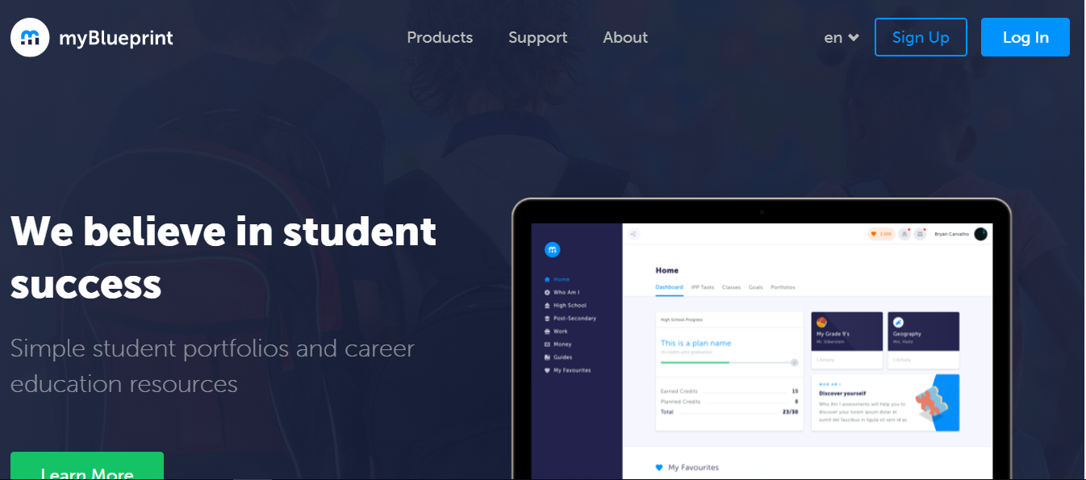
www.myblueprint.ca

Slide 22
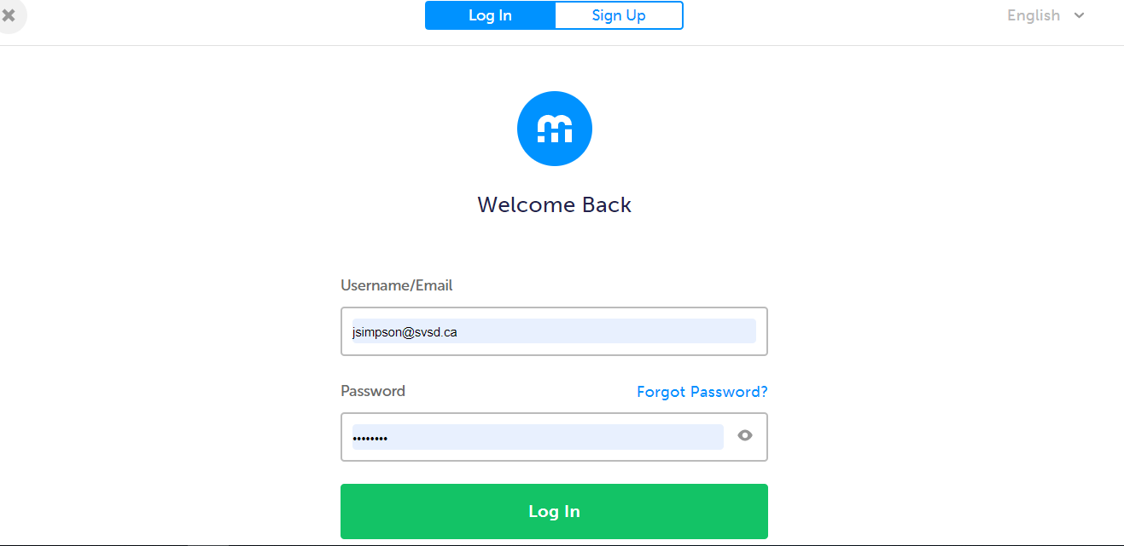

Slide 23
Now what?
Take home your course registration form for 2026 - 2027.
Discuss everything with your parents/guardians.
Bring your signed course registration form back to school by April 7.
Together we will be entering your courses into your “my blueprint” account.

Slide 24
The End
Please book an appointment with a counselor if you have any questions!!

