Slide 1
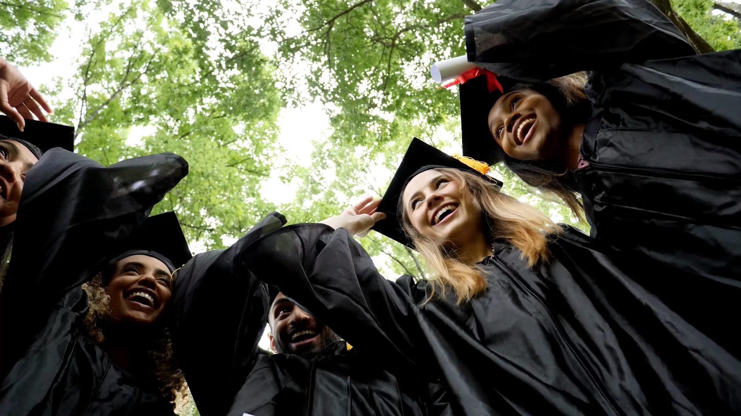
Graduation 2025
June 20th @ 3:00 pm
SVRSS Gymnasium

Slide 2
Meeting Agenda
SVSD Grad Policies- Grad Ceremony, Banquet, Safe Grad
Confirmed List of Graduates
Graduation Pathway Meetings for Students
Scholarships/Bursaries
Grad Photos
a. Grad Composite-Hangs at the SVRSS
b. Grad Group Picture- Day of Grad
c. Grads Photo on Stage with Diploma
6. Grad Swag
7. Grad Video includes Grad Slide Show
8. Grad Banquet
9. Safe Grad
10. Grad Retreat

Slide 3
SVSD Graduation Policy
Grad Steering Committee
Awards Committee
Banquet/Reception
Grad Souvenirs
Ceremony Committee/Design
Graduation Program
Ceremony Tickets
Graduation Gowns
Decorations
Awards
Ceremony Fee
Decorum
Accounting
Political Aspects of Graduation
Safe Grad Event

Slide 4
Grade 12 Pathway Meetings with Ms. Barabash
Ensuring all students are on the list-
Correct Legal spelling of name
Post Secondary Planning-
Applications
Living Arrangements
Student Aid/Funding Applications
Transcript Requests
Scholarships & Bursaries
Star & Times Form
Graduation Photos

Slide 5
Accuracy of Transcripts
Transcripts can be provided to students at any time as this is your property.
Please review and ensure accurate historical credits.
Honours and Distinction are based on the final marks on your transcript.
Credits taken at Adult Education, Informnet will count towards accummulated points as long as they are received in a timely manner.
Please note that credits with a "CO" are not used in the total points and .5 credits are assigned .5 points.

Slide 6
Bursaries & Scholarships
Awards’ Committee Chair, Ms Barabash
Committee composed of SVRSS Teachers
All Scholarship/Bursary Information Posted on Grade 12 Team
Specific Award Information
SVRSS Application for Awards
Application for local awards is available from Mid-April. All Applications are due by May 15.
Graduation Policy and Procedures to determine awards 9-30

Slide 7
Fees
Grad Fee= $ 50.00 (Diploma Photo, Ticket/Program paper, Decorations, Time Sensitive Grad Video Link
All other outstanding school fees, textbooks and devices must be reconciled before grad fee can be paid.
Any outstanding fees would be indicated in an SVRSS letter such as missing books or other materials.

Slide 8
Student Ceremony Committee
Committee comprised of Staff Advisors and interested students
Mrs. Harness-Main staff advisor
Students can sign up in the front hallway or show up to the first meeting-this will be announced on the Grade 12 Team.
Details on Ceremony particulars in SVSD Division Policy- handout and SVRSS Website

Slide 9
Important Dates
Grad Ceremony Rehearsal- Thursday, June 19 @ 1:00 in the Gym
All Grads Attending the ceremony must attend.
Grads will pick up their gowns following the rehearsal.
Group Picture- June 20th @ 2:15
Grad Day: Friday, June 20th @ 3:00 pm

Slide 10
Graduation Slide Show
Mrs. Petelski helps to put this together-student input needed
Need a baby picture and a recent picture
Submit pictures to Mrs. Petelski in the Resource Centre to be scanned or email to cpetelski@svsd.ca

Slide 11
Grad Photos
All Grad Photos must be booked online. Taking Place this week.
Grad Photo Session- $35.00- Composite Photo Only—No Cost
Retakes TBA-Spring
Call SVRSS Office if you have questions about the Lifetouch Photos

Slide 12
Graduation Souvenirs
Students may purchase a Grad Ring-these are organized through the Tigers Den.
Grad Hoodies – Mrs. Malkoske will be coordinating. Information TBA
Grad Banners-Have been provided as a Souvenir in the past-requires Fundraising and Parent Support to raise Funds.

Slide 13
Graduation Video
Videographer (Kevin Penner) has been hired for the Grad Ceremony
Time Sensitive Video Link available to all Grads to download after the ceremony.
This video and streaming service is provided from the SVRSS December Fundraiser.
Anyone wanting to purchase a DVD may do so by contacting Swan Valley Video Services @ 204-734-9179.
Mr. Penner’s Email- kcpenner@mts.net

Slide 14
Current Grad Funds
Grad Funds Raised to Date
2024 Carry Over: $ 5,000
December Fundraiser: $ 4,136.70
Donations: $
Other School Fundraiser: $
Total Current Funds= $ 8, 136.70

Slide 15
Grad 2025 Important Dates Summary
Grad Picture Retakes-TBA
Grad Souvenirs-TBA
May 15th Deadline
Grad Fees- $50.00
Scholarship and Bursary Applications
Grad Slide Show Pictures
Yearbook Quote and Toddler Photo to Mrs. Laychuk- dlaychuk@svsd.ca

Slide 16
Graduation Banquet
This is an optional event planned by parents.
This event is held at the Swan River Curling Club. Parent Chair required.
Teacher Support: Jen Zamzow for ticket sales

Slide 17
Other Fees and Information
Safe Grad Fee-TBD
Fundraising-All Grad Fundraising done together
Families will be receiving a final Grad Newsletter in May
Second Grade 12 Fundraiser to run in the Spring
Other Fundraising completed by the Safe Grad Parent Group to Finance Safe Grad

Slide 18
Contact Information
Grad Photos-SVRSS Main Office
Grad List/Scholarships-Ms. Barabash: jsimpson@svsd.ca
Grad Ceremony Committee- Mrs. Harness: kharness@svsd.ca
Grad Tickets and Slideshow Photos- Mrs. Petelski: cpetelski@svsd.ca
Yearbook- Mrs. Laychuk: dlaychuk@svsd.ca
Grad Banquet- Mrs. J Zamzow: jzamzow@svsd.ca
Safe Grad- Mrs. Glen: kglen@svsd.ca
Other Grad Queries: Mrs. Mydynski-Arp: jmydynski@svsd.ca

Slide 19
Grad Information Packages
Each Graduate has received their own package with pertinent grad information
Those packages that are not picked up at the Grad meeting are in the main office.
Next week the packages remaining will be mailed to individual families.
All Graduation related information (policies, newsletters, etc. ) can be found on our website
www.svsd.ca/svrss/page/459/graduation-information

Slide 20
What is Safe Grad?
Sponsored for the past 35+ years by Manitoba School Boards Association, Manitoba Public Insurance, and Liquour and Gaming Authority of Manitoba
Operates only through a Parent and Student Committee after the Grad class has completed a motion regarding if they want a Safe Grad—Motion has been completed.
Mrs. Glen is the SVRSS contact for Safe Grad.

Slide 21
Why Safe Grad?
Safe Grad was originally organized as a method of allowing our graduating students to have a final party that is enjoyable and accident free.
With the freedom that the Grads would like and the safety that you the parents need.
Safe Grad only operates with parent support and must be as “safe” as possible.
Held the past 22 years at the Swan River Curling Club in conjunction with the Grad Banquet so it flows from one event to the next.

Slide 22
Safe Grad Must…
Be organized by a parent committee
Follow the provisions of the Manitoba Liquor Control Act
Apply for Safe Grad Liability Insurance from MAST (Manitoba Association of School Trustees)
Follow Manitoba Public Insurance (re: transportation-everyone must be accounted for).

Slide 23
Committees and Their Importance
No Parents-No Party-No Fun
Tonight, we will form the working group that will be this Grad Years Safe Grad Committee
  Safe Grad Chairs
  Facility Chair
  Decorating Chair
  Entertainment Chair
  Prize Chair
  Fundraising Chair
  Security Chair
  Transportation Chair
  Food Chair
  Banquet Chair
  Bar Chair
  Clean Up Chair
  Medical Personnel

Slide 24
Committee Working Group
This committee is made of the Safe Grad Chairs, 12 Committee Chairs, minimum 5 student reps, and the School Rep
This group meets monthly at the SVRSS for March, April, May and then weekly or as needed in June.
Each Chair will receive a binder which contains previous years reports and guidance for the part of the committee you are taking care of.
All Parents/Adult family members will be needing to volunteer the night of Safe Grad to ensure that it runs smoothly and safely.

Slide 25
Facility
One Parent
Swan River Community Centre has been booked—contract to be signed
The person in charge will be responsible for working with the community centre to provide access to the rink for other committees as needed such as decorating.
The facility chairperson must also arrange to borrow tables and chairs enough for both the Banquet and Safe Grad events.

Slide 26
Decorating
3 Parents Recommended- walls, ceilings, tables
Most parents needed here
At least 10-12 sets of parents
Working with the students/parents and grad banquet where the rink is transformed into a themed atmosphere. This year the theme is yet to be decided. This takes time and planning to ensure that there is not a scramble at the end of June.
Student input and help is key

Slide 27
Entertainment
2 Sets of parents recommended
This committee will be working to provide things for grads and their guests to do at Safe Grad.
Student Input is key to this committee
This committee organizes the games which the grads and guests play throughout the evening
Parent help needed day of Safe Grad
Shifts of Parents start at 10:00 pm to 4:00 am
Detailed plan must be submitted to get liquor license
MLC will not grant us a license if entertainment is not organized

Slide 28
Prize Committee
2 sets of parents recommended
This committee approaches business for prizes or purchase prizes for the grads and their guests at Safe Grad
This is a big consumer of the fundraising money
One prize vs many smaller ones…TBA
Student input is key-do what they want
Buy Local

Slide 29
Fundraising
Raise funds to cover the expenses of Safe Grad
Recommended 3 parents to coordinate
Student Support is Key

Slide 30
Security
One Chair-Person that will be in attendance ALL NIGHT
Main job-knowing who is on the Safe Grad Guest List-SVRSS generates list and hands over to security.
Security is responsible for keeping an orderly event.
Ensuring that no one leaves Safe Grad by controlling all entrances.
Works with transportation to ensure that everyone gets home safely.
All participants of Safe Grad must be accounted for.

Slide 31
Transportation
One Chair-Person
The organization of this committee is essential to the insurance policy.
The organization takes place a couple of days leading up to the event—a large portion of our students in the last few years get collected from the event. However, if they need a ride we provide it for them.
The Committee is responsible for ensuring that all guest get home safely. Sign off required.
NO Grad or Guest can sign for themselves no matter what age.
Many parent volunteers needed day of, usually later shifts are more 2 am-6 am

Slide 32
Food/Concession
One Chair-Person Needed
No more than 6 sets of parents needed
Free food is provided during Safe Grad
It is the responsibility of the food committee to:
  Coordinate
  Prepare
  Serve this food to the grads, guests and the parents working at this event.

Slide 33
Bar
2 sets of Parents to sign liquor permit
The bar committee works with the Kinsmen Club in provided the bar services
This service club works with the bar, and the Kinsmen receives the profits.
It is the duties of the bar committee to provide the service club with what they need to obtain the liquor license.
Parents on this committee apply and sign for the liquor permit and must be present ALL NIGHT

Slide 34
Clean-Up
2 Chairpersons recommended
The Committee works throughout the evening cleaning up table areas and ensuring that bathrooms are clean.
This committee works with the facility chair as tables and chairs are all rented/borrowed for both events
The cleanup committee works after the completion of the events to get the facility back into the state that it was prior to grad.
Numerous recommendations from past years more parents needed
At least 10 families needed

Slide 35
Medical Personnel
Nurse/LPN/Doctor/First Responder/Fire Fighter needed to chair
Committee members must be medical personnel.
Must be present throughout the event until the last participant leaves.
No liquor license without this committee

Slide 36
Safe Grad Chairs
Follows MSBA’s Guidelines of “How to Plan Your Safe Grad”
Works with school representatives, students, and committee chairs to plan function
Responsible for the organization of future meetings, where decisions are made
Responsible in seeing that Safe Grad is planned and that there are no problems within the individual committees
Is the go-to person/ final decision maker for the Safe Grad Event
Must be in attendance ALL NIGHT

Slide 37
Committee Chair Volunteers
Committee Chair Fills
Volunteers for Committees
This event has as many adults as Grads & Guests
Questions?
For those that have a binder and have signed up please stay after this meeting-First committee meeting will be March 18th at 7:00 pm at the SVRSS Cafeteria.
Thank you for Volunteering! Committee Chairs will be in contact when help is needed.

